Slide 1

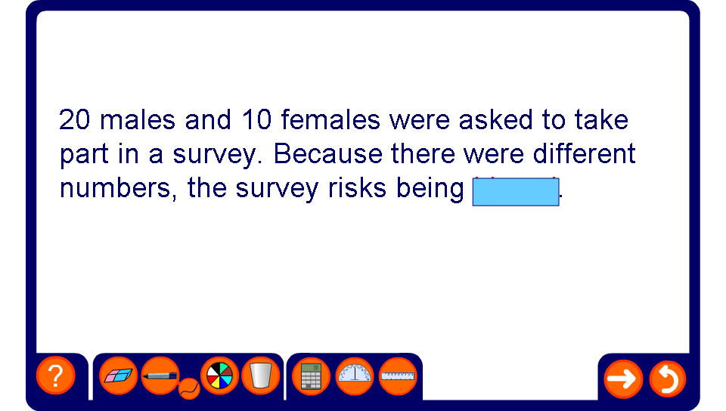


Using key words
Notes:
This activity could be done as a competition in groups, with the first group to provide the correct word the winner. (This could be done on mini whiteboards, or by running to the teacher with the word written down.)

